Slide 1
Experiential Activity

Slide 2
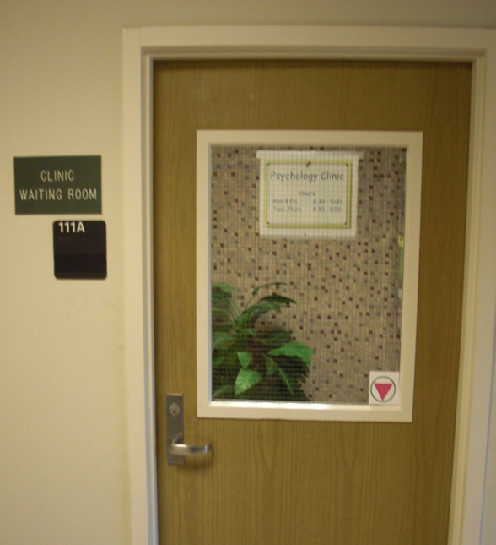

Slide 3
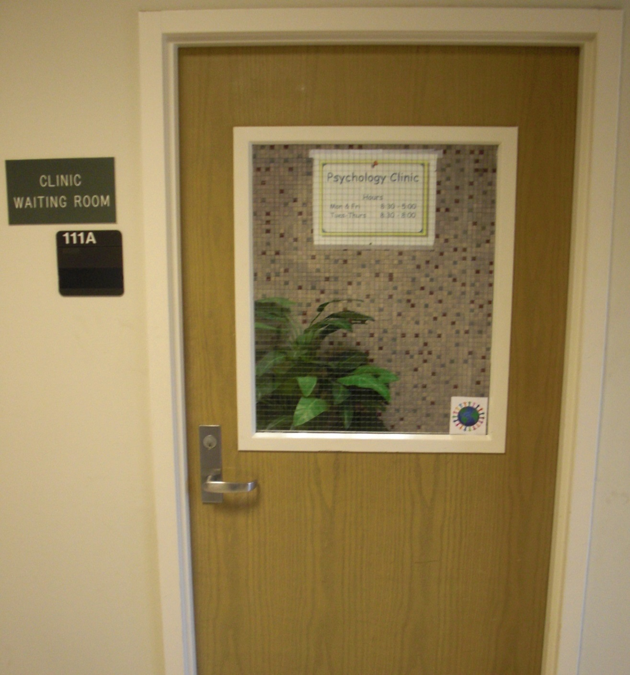

Slide 4
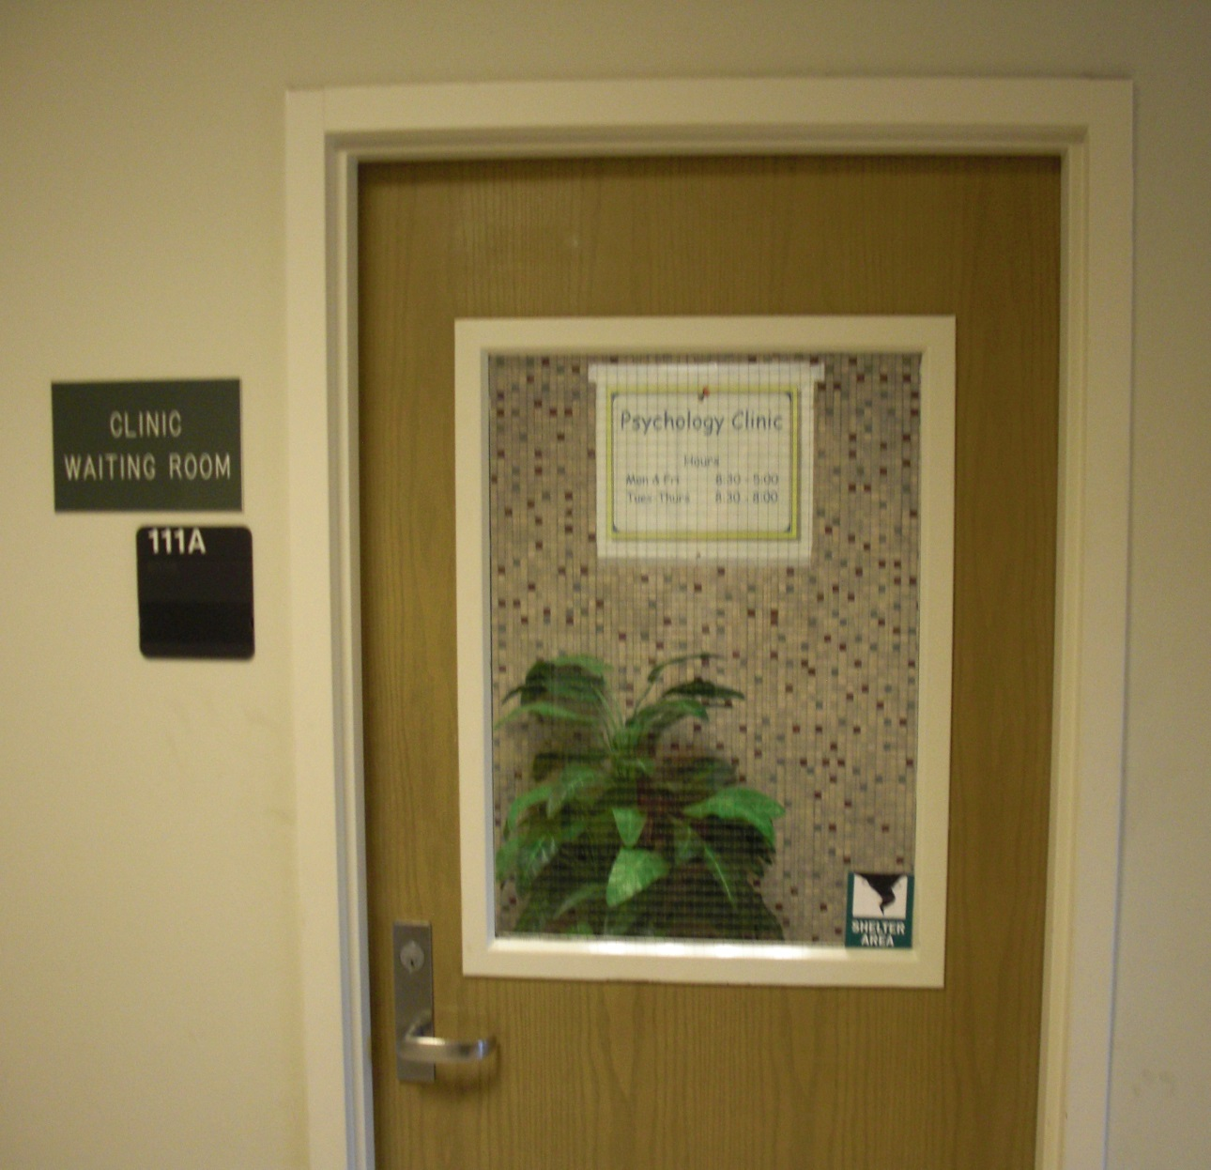

Slide 5
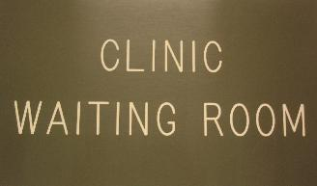





Slide 6
The Safe Zone Symbol: Its Impact on Attitudes Toward Seeking Mental Health Services
Marshall Bewley, Ph.D.
Texas Woman’s University Counseling Center

Slide 7
Learning Objectives
Understand the impact of the Safe Zone Symbol on clients’ willingness to seek treatment
Consider the implications of Safe Zone Symbols at your internship site.
Identify ways in which explicit affirmation can be implemented at your internship site

Slide 8
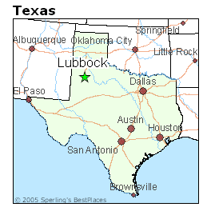
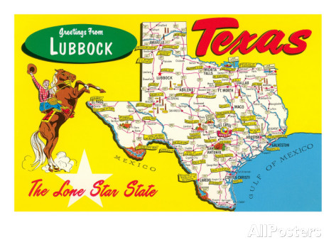
Interest in The Safe Zone…

Slide 9
Psychologists are called to “respect the dignity and worth of all people” by being “aware of and respect[ing] cultural, individual, and role differences, including those based on age, gender, gender identity, race, ethnicity, culture, national origin, religion, sexual orientation, disability, language, and socioeconomic status and consider[ing] these factors when working with members of such groups” (APA, 2010, p. 3).

Slide 10
Lesbian-Gay-Bisexual-Transgender-Questioning/Queer (LGBTQ)
LGBTQ community ~10% of the population (Buhrke & Stabb, 1995)
  Same Gender Attraction ranging even higher in adults
LGBTQ individuals utilize counseling services significantly more than heterosexual individuals (Bieschke et al., 2000; Pelton-Sweet & Sherry, 2008)
  LGBTQ Clients likely are a big part of your Center’s Clientele
Notes:
** Thus, LGBQ may be a likely source of potential clients in m.h. clinics
Attraction even higher
By age 26, 11% of men and 25% of women reported being attracted to their own sex at some time (Dickson et al, 2003)
At any point in time, 5-7% of men and 12-20% of women will report same-sex attractions (Diamond, 2014)

Slide 11
Victimization of LGBTQ
LGBTQ more likely to be target of hate crime than any other Minority Group
  18% of all reported hate crimes are related to sexual orientation (Uniform Crime Report, 2008)
  Violence against Transgender individuals
    Black and Latina Transwomen*
Bureau of Justice Statistics estimated there may be 40 times more hate crimes occurring nationally than FBI reports
Notes:
2007 National School Climate Survey, the Gay, Lesbian, and Straight Education Network (GLSEN)
Mention Recent Suicides**.
Majority of victims of hate violence homicides (72%) in 2013 were transgender women
At least 15 transgender people murdered in 2016
a new analysis of data gathered by the Federal Bureau of Investigation by the New York Times reveals LGBTQ community more likely to be target group than any other minority group

Slide 12
Hostile Environment
LGBTQ students: 86% verbally harassed, 44% physically harassed, 25% physically assaulted, 75% heard homophobic remarks (Kosciw, Diaz, and Greytak, 2007)
LGBTQ individuals typically experience an unsafe and homophobic campus (Bontempo & D’Augelli, 2002; Brown et al., 2004; D’Augelli & Rose, 1990; Evans, 2001; Herek, 1989; Kosciw et al., 2007; Walls, Kane, & Wisneski, 2010)
LGBTQ students perceive campus more negatively and unsure of where support lies (Brown et al., 2004; Walls, Kane, & Wisneski, 2010)

Slide 13
Safe Zone
‘Safe Zone’ provides a safe place and combats stigma & discrimination faced by LGBTQ individuals
Embracement of symbol to visibly affirm, support, and accept LGBTQ community
Notes:
The inverted pink triangle was a Nazi symbol used to identify gay men (actual or perceived) in the concentration camps during the holocaust of World War II. The icon has been reclaimed by many in the gay rights movement as a symbol of empowerment and, by some, a symbol of remembrance to the suffering of others during a tragic time in history.

Slide 14
Effects of Safe Zone Symbol
Evans (2002)
  Safe Zone symbol stickers passed out on a campus
  5000 symbols passed out; 314 visible 3 years later
  Safe Zone symbol can bring ease and feelings of protection and comfort to LGBTQ individuals
  Concern of a false sense of security (No Training) & added stressors on ‘closeted’ LGBTQ individuals
Notes:
42 participants interviewed about their experiences.
Stress for closeted because may be apprehensive around the symbols
42 participants (GLBT students, faculty, staff, and allies who displayed Safe zone symbols) at Iowa State University were interviewed for the study. Participants were provided a Safe Zone symbol to show their affirmation and awareness for GLBT individuals. Throughout the project, faculty and students were interviewed about the Safe zone project. The purpose of the interviews was to determine perceived goals, motivation, and reactions to posting a Safe Zone symbol.

Slide 15
Study I
Investigated individuals’ comfort with mental health clinic displaying a SZ symbol (Hardin & Bewley, 2010)
  Noticing Symbol
  81% waiting room sign, 84% Absent Accessibility Sign
  43% correctly remembered seeing SZ symbol
  LGBTQ noticed SZ symbol, Heterosexual Did not
  Over ½ of sample unaware of meaning,
    Of ½ that stated they were aware, only 1/3 reported symbol was related to sexual orientation
Notes:
A pilot study conducted to determine effects that the GLBT Safe Zone symbol has on individuals’ comfort with a mental health clinic (Hardin & Bewley, 2010).
-- White; Non-hispanic European American
--Both samples “somewhat” religious (averages of 3.19 for introductory psychology students and 3.53 for community participants on a 5 point scale from (1) “not at all” to (5) “extremely”)
139 introductory psychology (94% Christian, 97% Heterosexual, 78% White, & 67% Women)
68 community members (82% Christian, 72% Heterosexual, 86% White, & 64% Women)
Both samples “somewhat” religious
LIMITATIONS OF STUDY I
Sample: Predominately White, Christian, Heterosexual, Women
Women tend to hold less prejudiced views (Brown et al., 2004; D’Augelli & Rose, 1990; Klamen, Grossman, & Kopacz, 1999; Lambert et al., 2006; Liddle, 1996; Malaney, Williams, & Geller, 1997)
Small # of LGBQ participants (n = 22)
Didn’t assess degree of outness
Does ‘Comfort’ Impact Seeking Treatment?
Sample: Predominately White, Christian, Heterosexual, Women
Women tend to hold less prejudiced views (Brown et al., 2004; D’Augelli & Rose, 1990; Klamen, Grossman, & Kopacz, 1999; Lambert et al., 2006; Liddle, 1996; Malaney, Williams, & Geller, 1997)
Small # of LGBQ participants (n = 22)
Didn’t assess degree of outness
Does ‘Comfort’ Impact Seeking Treatment?
PSY 1300: On average, the sample reported being “somewhat” religious [M (SD) = 3.19 (0.99) on a 5-point scale from not at all to extremely; see Procedure section below] and moderate in their religious beliefs [M (SD) = 5.61 (2.79) on an 11-point scale from liberal to conservative;
COMMUNITY: On average, the sample reported being “somewhat” religious [M (SD) = 3.53 (1.08)] and somewhat liberal in their religious beliefs [M (SD) = 3.85 (3.12)].
Not only did most participants not notice the symbol, but over half of the participants did not know what the symbol meant. Specifically, only a third of participants (~32%) accurately reported that the symbol had to do with sexual orientation.
The pilot study (Hardin and Bewley, 2010) also investigated whether participants might be less comfortable seeking services from a clinic that had a Safe Zone symbol on the door. After participants stated their initial comfort level, their attention was specifically drawn to the symbol and its meaning. Results from the pilot study revealed that participants’ comfort levels were unaffected by having their attention drawn to the symbol and its description. Additionally, four doors were used (e.g., Rainbow symbol, Pink symbol, Subtle symbol, control – no symbol) to determine whether different Safe Zone symbols that differed in ambiguity would affect comfort levels. Again, comfort levels were unaffected regardless of which door or symbol was viewed.

Slide 16

Study II
Safe Zone Symbol
Diversity Symbol
Tornado Symbol (Control)
Notes:
For the Safe Zone Symbol, the statement read, “The symbol above is sometimes called a ‘Safe Zone’ symbol. It is used to indicate that the room within is safe for gays, lesbians, bisexuals, and transgendered persons and that persons of all sexual orientations are affirmed. Knowing this now, we'd like to ask you again about the effects of the physical environment on your attitudes.”
For the Diversity Symbol, the statement read, “The symbol above is used to indicate that the space within is safe for individuals regardless of their ethnicity, gender, religious orientation, sexual orientation, age, or ability.

Slide 17
Research Questions
Research Question #1
Do individuals notice and/or know meaning of the Safe Zone symbol?
Research Question #2
What’s the effect on initial willingness to seek therapy?
Research Question #3
Do participants’ willingness to seek therapy change when they are provided the meaning behind either diversity-related symbol
Research Question #4
Is participants’ level of religiousness related to their willingness to seek therapy?
Notes:
RQ 1 : Do individuals notice the Safe Zone symbol on the door?

Slide 18

Method
Participants
  N = 339
  211 - Heterosexual Participants, 126 - LGBTQ
  Majority were White, Christian, and Highly educated
Notes:
--minimum of 42 participants in each of the three LGBQ groups; & a minimum of 69 participants in each of the three heterosexual groups.
--Majority were Caucasian (76%), Christian (76%), Heterosexual (61%), and highly educated (52% had some college; 91% had more than high school diploma).
--Community Recruited through APA’s Division 44 listserve, GLBT nightclubs, community churches
Recruitment emails (see Appendix B) were sent to a various Texas Tech University student organizations, such as the Intervarsity Christian Fellowship, Campus Crusade for Christ, Reformed University Fellowship, Latter-Day Saint Student Organization, Catholic Students Association, Lutheran Student Fellowship, Men of God Christian Fraternity, Muslim Student Association, and Paradigm Bible Study. Further, national organizations were contacted to recruit LGBQ individuals. Specifically, both the local and national sector of Parents, Families, & Friends of Lesbians and Gays (PFLAG) were contacted and recruitment emails posted on the PFLAG list-serve. From the list-serve, over 350 PFLAG leaders across the United States were contacted with the recruitment email. Other LGBQ organizations contacted included the Texas Tech University Gay-Straight Alliance, South Plains College Gay-Straight Alliance, and Equality Texas (i.e., Human Rights Campaign Group). To have a more diverse sample, the primary investigator recruited participants within the community and general public (e.g., LGBQ nightclubs) by passing out recruitment flyers with information and a link to the study (Appendix B).

Slide 19
Method: Measures
Intentions to Seek Counseling Inventory (ISCI) (Cash, Begley, McCown, & Weise, 1975)
Duke Religion Index (Koenig et al., 1997)
Religious Fundamentalism (Altemeyer & Hunsberger, 1992, 2004)
Social Desirability Scale (Strahan & Gerbasi, 1972)
Demographic Information Form
Notes:
Intentions to Seek Counseling: 17-item measure wherein respondents rate from 1 (very unlikely) to 4 (very likely) how likely they would be to seek counseling if they were experiencing the problem listed.
--Problems include choosing a major, weight control, relationship difficulties, self-confidence problems, overuse of alcohol, personal worries, difficulty in sleeping, concerns about sexuality, procrastination with schoolwork, difficulty concentrating, depression, fear of failure, improvement of self-understanding, relaxation training, test anxiety, loneliness, and drug problems.
--For the purposes of this study, the scale was revised to fit with items assessing participants’ willingness to seek counseling from this particular mental health clinic. For example, the directions read, “Assume that you are experiencing each problem and then rate your likelihood of seeking help at this mental health clinic for each of the following issues.”
--Scale responses were summed, with higher scores indicating a greater likelihood of seeking counseling for each of the three types of concern.
Possible score Range is 17 - 102
Cultural Congruity Scale: 13-item Cultural Congruity Scale (CCS; Gloria & Robinson Kurpius, 1996)
--scale was revised to fit with items assessing participants’ values and those of the mental health clinic. For example, I feel that I would have to change myself to fit in at this university was changed to I feel that I would have to change myself to fit in at this mental health clinic. The 13-items was based on a 7-point Likert-type scale ranging from 1 (not at all) to 7 (a great deal; see Appendix G).
--Scores found by summing individual’s item responses after reverse scoring items 1, 2, 3, 4, 6, 7, 9, and 10. Individuals’ scores can range from 13 to 91, with higher scores indicating greater perceived congruity of values.
Outness Inventory: (OI; Mohr & Fassinger, 2000), 10 item self-report measure that assesses the degree to which individuals are open about their sexual orientation in different areas of their lives. (family, religious congregation, and everyday life (e.g., work, friendships). Likert scale 1 (person definitely does not know about your sexual orientation status) to 7 (person definitely knows about your sexual orientation status, and it is openly talked about). Each item on the 10 item scale identifies a specific individual (mother, father, siblings), others in an individual’s life (work peers, strangers, new acquaintances), and religious community (leaders of religious community). Each participant rates the degree of outness for that individual, with higher scores indicating greater disclosure of sexual orientation.
--Scores range from 0 to 70
Duke Religion Index: covers three major areas of religiousness: the organizational (1 item; attendance at religious services), non-organizational (1 item; prayer or religious study), and subjective or intrinsic (3 items; experience the presence of the Divine) dimensions of religiosity.
--Participants’ responses were summed, with the total score ranging from 5 to 27.
--Sample items included, “how often do you spend time in private religious activities, such as prayer, meditation, or Bible study?” and “my religious beliefs are what really lie behind my whole approach to life.”
Religious Fundamentalism Scale: 12-item measure using an 8-point Likert scale response format where responses range from very strongly disagree with a statement to very strongly agree with each statement, with higher scores indicating higher levels of religious fundamentalism.
---Sample items: “God has given humanity a complete, unfailing guide to happiness and salvation, which must be totally followed,” and “when you get right down to it, there are basically only two kinds of people in the world: the Righteous, who will be rewarded by God; and the rest, who will not.”
Social Desirability Scale: used a 10-item revised form (Strahan & Gerbasi, 1972), of which 5 are marked "true" items (i.e., highly desirable behaviors but low likelihood of occurring) and 5 are marked "false" items (i.e., socially disapproved behaviors but high likelihood of occurring). -------Sample items include “I'm always willing to admit it when I make a mistake” and “There have been occasions when I took advantage of someone.”
--For purposes of this study, a 5-point Likert scale was used (e.g., 5-Strongly Agree, 4-Agree, 3-Neither Agree nor Disagree, 2-Disagree, 1-Strongly Disagree) rather than the True - False answer key.

Slide 20
Results
Symbols Present?
  Significant Differences between who Noticed Symbol between LGBTQ and Heterosexual Participants
Notes:
HYPOTHESIS 1a was supported that a majority of heterosexual participants would not notice the Subtle symbol.
Hypothesis 1b was supported, indicating that fewer heterosexual participants noticed the symbol than LGBQ participants
To compare whether LGBQ participants’ level of outness influenced whether they noticed the Subtle symbol or not (Hypothesis 1c) was rejected
-- an independent samples t-test was calculated comparing the overall OI scores of LGBQ individuals who did and did not notice the symbol. However, there was a not a significant difference in the level of outness for LGBQ individuals who noticed the symbol (M = 4.64; SD = 1.57) and those who did not notice the symbol (M = 4.44; SD = 1.80); t(40) = -.377, p > .71.
To test whether the findings for Research Question #1 were related only to the Subtle symbol itself, the primary researcher also investigated the frequency of noticing the other two symbols. Specifically, a chi-square test of independence was calculated comparing the frequency of noticing the Diversity symbol between LGBQ participants and heterosexual participants in Diversity group. However, there was not a significant effect [χ² (1) = .26, p = .61], indicating that sexual orientation did not significantly influence whether someone noticed the Diversity symbol. Specifically, a majority (66%) of heterosexual participants (48/73) and a majority (61%) of LGBQ participants (25/41) in the Diversity group did not remember noticing the Diversity symbol. Additionally, a chi-square test of independence was calculated comparing the frequency of noticing the Tornado symbol between LGBQ participants and heterosexual participants in the Tornado group. A significant effect was found [χ² (1) = 5.88, p < .02], indicating that sexual orientation significantly influenced whether someone noticed the Tornado symbol. Specifically, 57% (24/42) of the LGBQ participants in the Tornado group noticed the symbol, compared to only 34% (24/71) of heterosexual participants noticing the Tornado symbol.

Slide 21
Meaning of Subtle Symbol?
~ 2/3 of participants had “no idea” of symbol’s meaning
  Only 28% of those who offered a meaning for symbol stated something about sexual orientation
  Sexual orientation influenced whether someone accurately knew the meaning of Subtle symbol
  62% of LGBTQ participants accurately knew meaning
  Only 6% (6/104) of heterosexual participants accurately knew meaning
Notes:
Please refer to Appendix M for a complete listing of the meaning behind both diversity-related symbols and Appendix N for a complete listing of qualitative comments from participants.

Slide 22
Explicit
Affirmation!

Slide 23
Importance of Study
Consistent with Study I showing differences between LGBTQ and Heterosexual participants in noticing and understanding meaning of the Safe Zone symbol
Safe Zone Symbol continues to show a significant positive impact for LGBTQ individuals
Explicit affirmations increase positive attitudes toward a clinic
Results should ease concerns that displaying a symbol that overtly affirms sexual orientation might disaffirm other clients
Notes:
Even if clients feel uncomfortable with a Safe Zone symbol displayed, they are still actually willing to seek counseling from the clinic.
********Future research should investigate how a mental health clinic could minimize a client’s discomfort with a mental health clinic displaying a Safe Zone symbol, such as determining whether having other material (e.g., magazines, pamphlets) that affirms aspects of religious diversity could mitigate the discomfort.
Lack of findings related to participants’ initial attitudes toward the mental health clinic suggest that displaying a symbol alone may not be sufficient in bringing affirmation to a wider range of individuals. It appears that explicit affirmations increase positive attitudes toward a mental health clinic, as seen by the results showing that describing any kind of affirming symbol seemed to lead to an increased willingness to seek counseling and a trending increase in perceived congruity of values. Could talk about the large # of participants knowing the diversity symbol, yet it still didn’t make them feel more comfortable
***Safe Zone Symbol or Diversity Symbol Had No Negative Effects of willingness to seek treatment
***Even if clients feel uncomfortable with Safe Zone symbol displayed, they were still actually willing to seek therapy from the clinic
***Heterosexual participants did not notice the symbol in the first place, and even less likely to understanding the meaning

Slide 24
“I'm gay, so it eases me to know I'm entering a safe zone.”
“Living in this area, LGBTQ people need to be able to have an outlet for their problems and frustrations. A Safe Zone sign, will give those who see it a sense of relief when entering the office. The only downfall to this is that the sign is only visible to those who are already prepared to enter the facility, and does not necessarily reach out to those who may just be passing by.”
“I'm still indifferent on how the image of the door makes me feel. Even the "safe place" image doesn't change that. If I'm going to this office, I've already decided that I'm going to be myself and honest. It's the doctor inside the office that will make me feel that I'm accepted or not.”

Slide 25
Criticism of Symbols /
Implications for Training
How do we know ourselves as Trainers / Therapists or our Trainees are actually providing a Safe Zone?
  Only obtaining a Safe Zone Symbol after completing an Ally training
  Affirmative clinical work with LGBTQ clients?
Are Trainees aware of APA Guidelines?
  Psychotherapy With LGB Clients?
  Psychotherapy With Transgender & Gender Nonconforming People?
  Standards of Care for the Health of Transsexual, Transgender, and Gender Nonconforming People?
Notes:
World Professional Association for Transgender Health

Slide 26
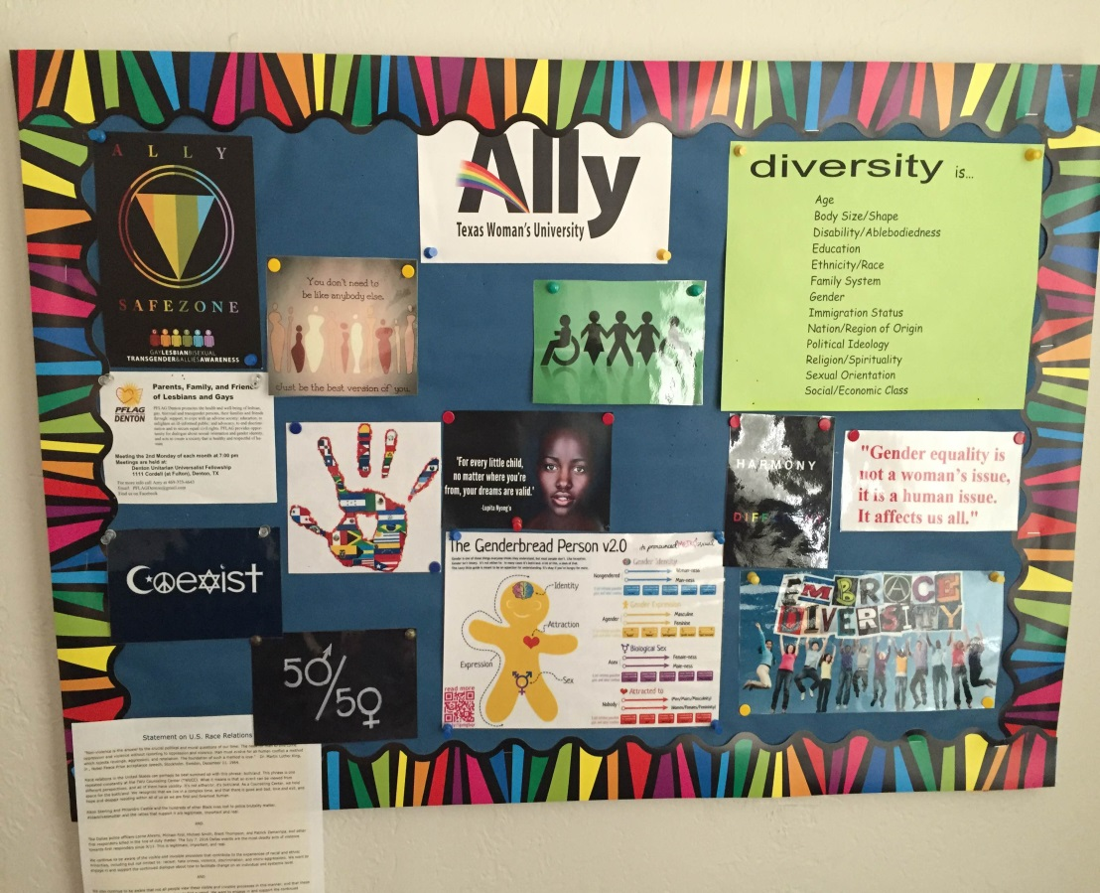
Importance Related to Training
SZ Symbol likely has positive impact for LGBTQ interns, practicum students, colleagues
Explicit affirmations increase positive attitudes for ALL within the Center’s Culture
Letter to Applicants
Notes:
Internship site more
desirable to LGBTQ
individuals / colleagues
with more explicit
affirmations

Slide 27
Creating ‘Safe Zones’ for Trainees
Environment:
  Do All Supervisors Display Safe Zone Symbols?
  Magazines Displayed, Groups Offered
  Leaders of Ally Trainings?
    Are Interns and trainees required to attend?
  Response to Current Events
  Do you have diverse identity label options on paperwork at your site
Notes:
Response to Current Events (Orlando & Latinx, BlacksLivesMatter)
Environment:
Do All Supervisors Display Safe Zone Symbols?
Magazines Displayed
Types of Groups Offered
Leaders of Ally Trainings?
Are Interns and trainees required to attend?
Response to Current Events
Do you have diverse identity label options on paperwork at your site?

Slide 28
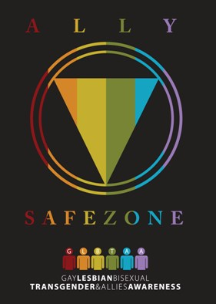

Other things to Consider
How are Sexual Orientation & Gender Identity/Expression Discussed in meetings/conceptualizations?
Internship Interviews: (vignettes, experience)
Do All Staff Members Affirm / View Non-Pathologizing Manner?
How explicit are your Ally Symbols?
Notes:
Art therapists and other mental health professionals need to understand that homosexuality is no longer categorized as a mental illness or disease (American Psychological Association, 2005)
Internship Interviews: Asking about LGBTQIA issues (i.e., vignettes, experience)

